Slide 1
Dream Tools
Notes:
Given it’s a smallish room, we’ll be a smallish group and not very able to divide into sub-groups
So I think lets get people to work together if they want
This is very loosely prepared
I’d just like to try to be creative around questions of audiences and what could be built for them
Particularly perhaps from text of primary sources, but not necessarily only that
I’ve put a few examples around the room – some things you’ve seen before, some of the wackier views from Voyant, a couple of interfaces that I just happen to like
But to begin I’d just like to do an exercise around thinking about who your audiences are

Slide 2

Who are the audiences?
Who are Wellcome’s existing audiences?
Which ones do you face in your work?
Are there internal audiences?
What new audiences could Wellcome develop?
Or would you personally like to develop?
What might these audiences want or need?
What might you want to communicate to them?
Notes:
Initially a post-it exercise around “who are the audiences, who could the audiences be”?
15-30 minutes to develop ideas
Which can just be scribbled on post-its
Or scribbled on paper
Then another ½ hour or so to feed back
Particularly interested in ideas around exploiting the digitized text, but other ideas could also be of interest
And of course ideas around digitized text can be combined with other ideas

Slide 3
Who is it for?
An existing audience?
Which one(s)?
A new audience?
An internal audience?
It could just be for you!
Notes:
Paper prototyping/dream tools
Just write down thoughts/ideas
Or literally sketch out what a visualization or interface might look like
In groups or individually, as you prefer
Here are some I prepared earlier...
My remaining slides are just some things you may want to consider, I’ve printed them out too
Thinking about the audience that you’re aiming to reach will surely influence whatever you might create
Or you might want to create a new audience
One that I think about is hackers, in the positive “playing with software” sense of hacking
If you create data and tools that people can build upon, creative people with the right skills will turn up and do just that
Or at least, that’s the theory, but there’s always the risk that you build it and they don’t come
It doesn’t necessarily have to be for an external audience
It could even just be something that would help you in your own work, I think that’s completely legitimate
And of course if it is helpful for you then it could be helpful for others

Slide 4
What does it surface?
Tells a story about the past?
Electro-quacks
Disease outbreaks
Or about the collection?
It’s really varied
It has interesting gaps
Or a single text, or an interesting piece of data, or the hazards of technology, or ...

Slide 5
How does it work?
Static
You control
Tells the user something that you want to communicate
Filtered through your expertise
More traditional author/audience model
Or artist/audience
Interactive
User controls
Lets the user find something out, tell their own story
Possibly with guard rails
More democratic
Perhaps users can even add to the content?
Notes:
Artist/audience – some people do work with data vizualisation which is maybe more akin to art than to more “authorial” forms of communication
Although what I have in mind here is more stuff created “by hand” in some sense, some of Voyant’s views are of this form
Guard rails – a bit vague, but something I’ve heard talked about in the context of digital publications
So e.g. communicating some piece of historical research through an interactive website instead of (or as well as) more traditional publications
The general idea is that the user has some freedom in how they interact with the resource, but that the resource guides them in some way
Perhaps its a bit similar to the illusion of freedom in computer games which can give the impression that you are interacting with an open world
Anyway, I think the point is to find a compromise between freedom to explore and expert guidance
Even if I’m not entirely clear on how we do that
As we were discussing the other day, the position of expertise can bring some difficulties
There is certainly interesting work being done with people who are (arguably) non-experts
This includes expertise from outside the GLAMA space, such as engaging with the communities that a collection is about
And volunteering/crowdsourcing, e.g. there is a researcher in Japan who has experimented with building a social media type platform in which users provide transcriptions or metadata
Or one of the Scandinavian National Archives (I forget which one) which is making use of volunteers to transcribe its collection
Including getting volunteers to review one another’s work
Finding that they are stricter reviewers than the NA’s own staff

Slide 6
What is actually possible?
You can take some inspiration from what you see around the room
And what we’ve talked about before
And anything else in your experience
But, for the most part, don’t worry about it!
Notes:
This is where the “dream tools” part comes in
I think there is value in thinking about what we would like to be able to do, without worrying too much about the practicalities of doing it, or even if it is possible yet
Even if you dream up something impossible, it might point us in a direction

Slide 7
END

Slide 8
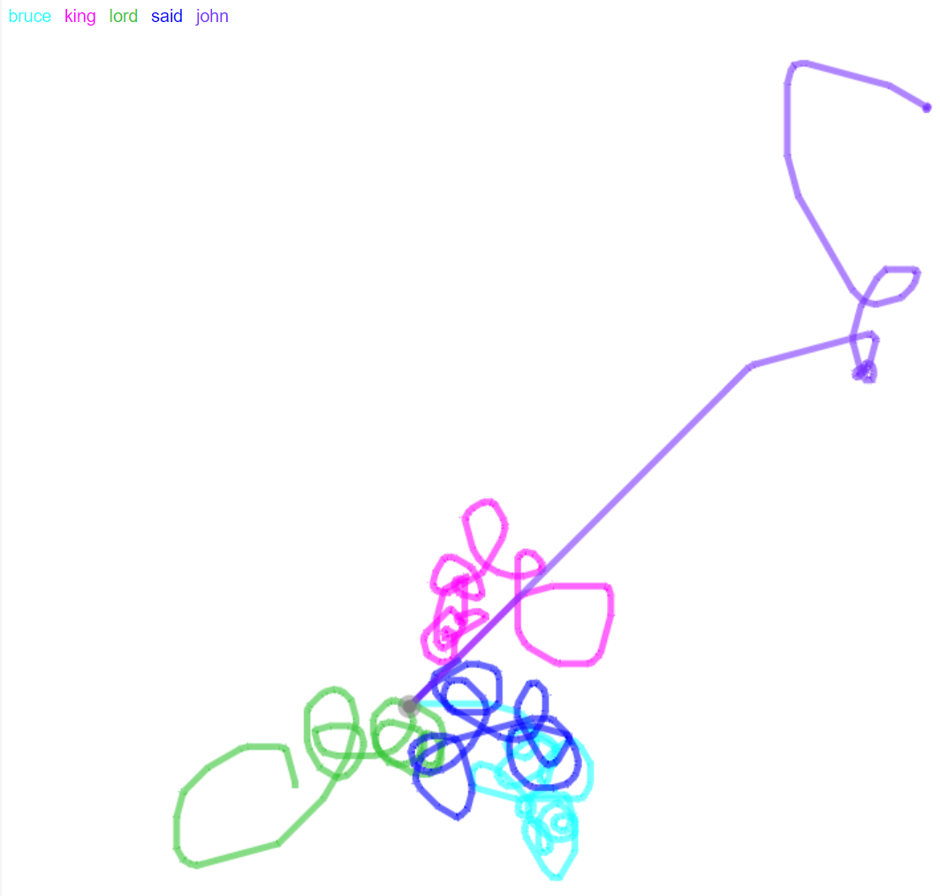
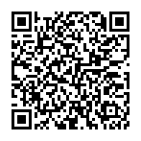
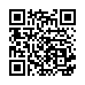
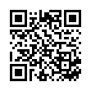
Knots
Knots (via Voyant)
“Knots is a creative visualization that represents terms in a single document as a series of twisted lines. Each occurrence of a term is represented by a bend in the line, so the more twisted a line, the more a term repeats and straight stretches represent no occurrences.”
In Voyant this is animated, with optional sound.
Lots of repetition of frequent terms here, in Walter Scott’s “Lord of the Isles”.
But John’s line stands out.
Catalogue: https://wellcomecollection.org/works/m9sx3wqk
Text: https://api.wellcomecollection.org/text/v1/b28146347

Slide 9
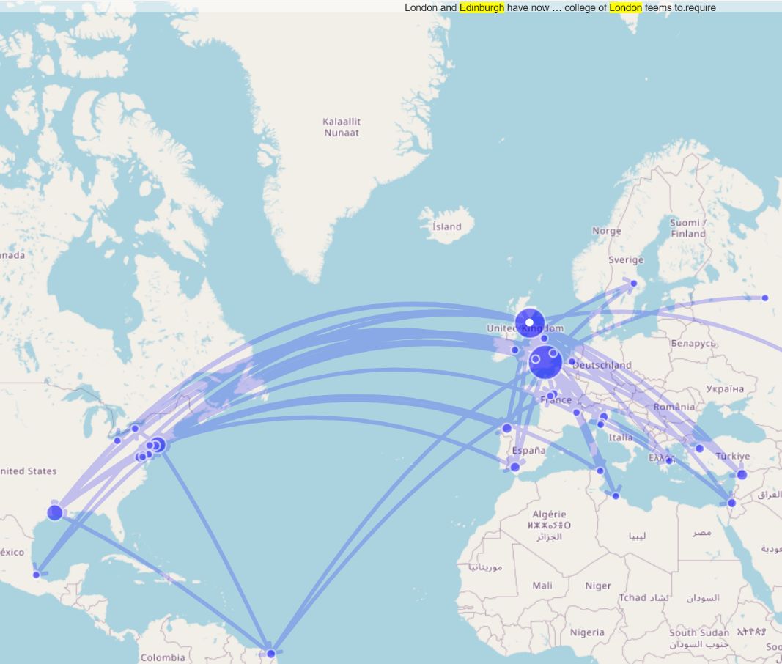
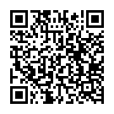
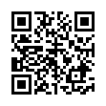
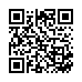
Dreamscape
Dreamscape (via Voyant)
Dreamscape tries to show connections between locations.
It cycles through text that it thinks connects locations (visible at top) and highlights that connection in the map.
Here with a materia medica text, I was hoping for a greater range of locations.
Locations in the USA include Sulphur, Linden, Macedonia, Batavia, Vienna, Bethlehem... an example of tool bias and the dangers of raw data.
Catalogue: https://wellcomecollection.org/works/xwe9pkn7
Text: https://api.wellcomecollection.org/text/v1/b30410332

Slide 10
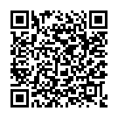
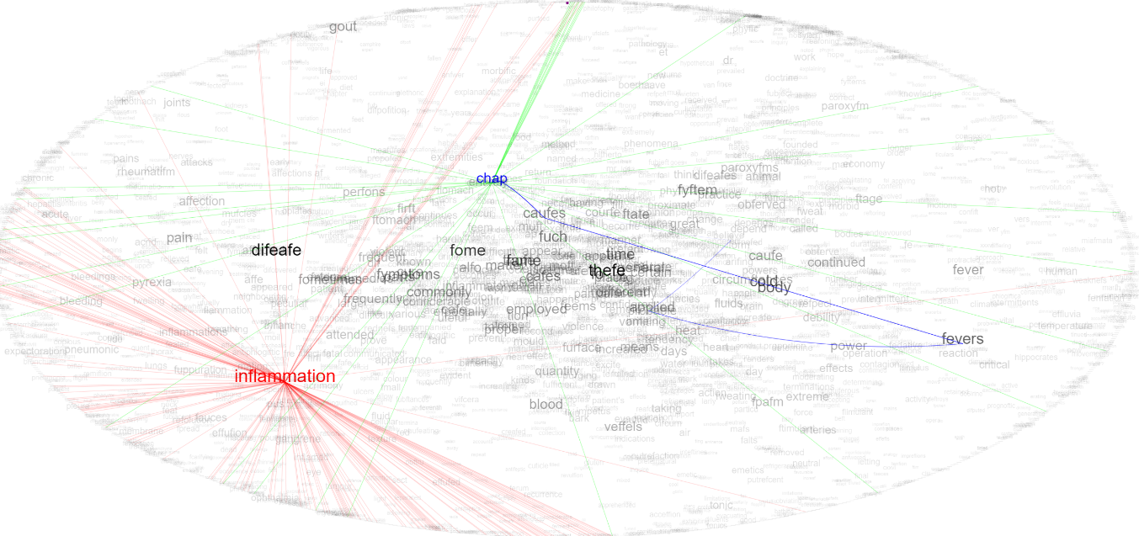
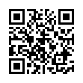
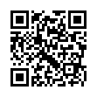
TextArc
TextArc (via Voyant)
The perimeter represents every word in the text, in order.
Within the oval, each word is “dragged” towards its positions on the perimeter -- so it is at its “average” position in the text.
Highlighting “inflammation” shows where it appears in the book.
Perhaps like a “word cloud”, but with added information about word location.
What would this look like if texts were ordered by date? Or by genre/subject?
Catalogue: https://wellcomecollection.org/works/h9dygqr6
Text: https://api.wellcomecollection.org/text/v1/b21112174

Slide 11
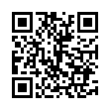
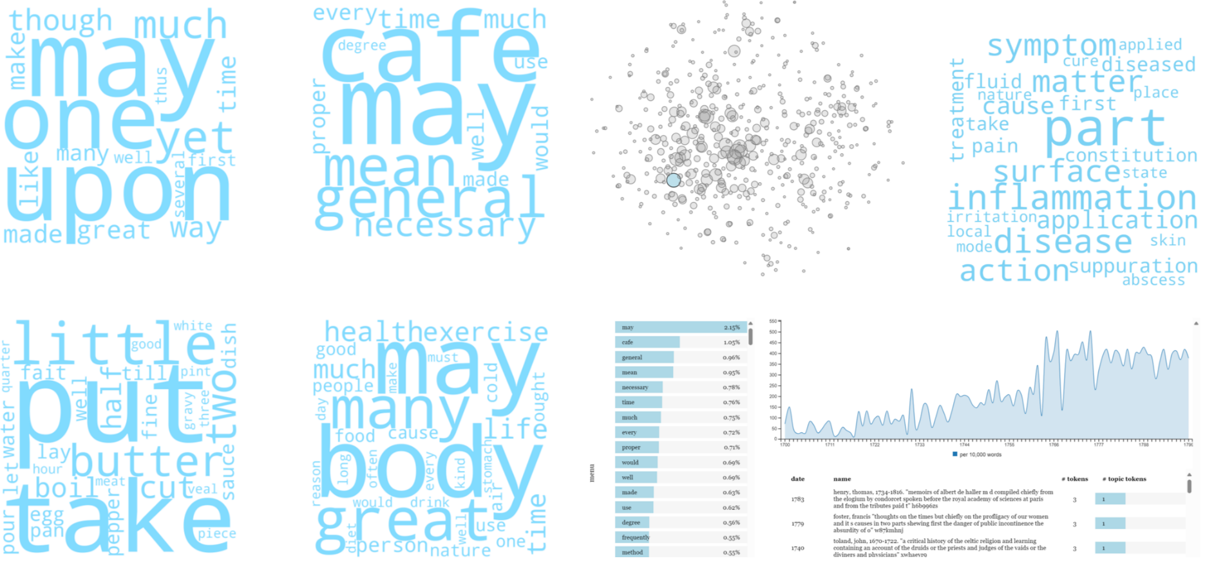
HaToRI
Wellcome-ised version is just on my laptop, but the original Hansard version is here →

Slide 12
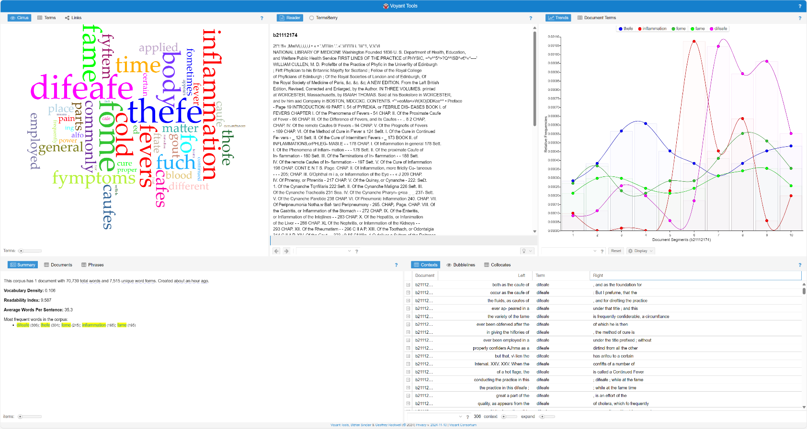
Default Voyant

Slide 13
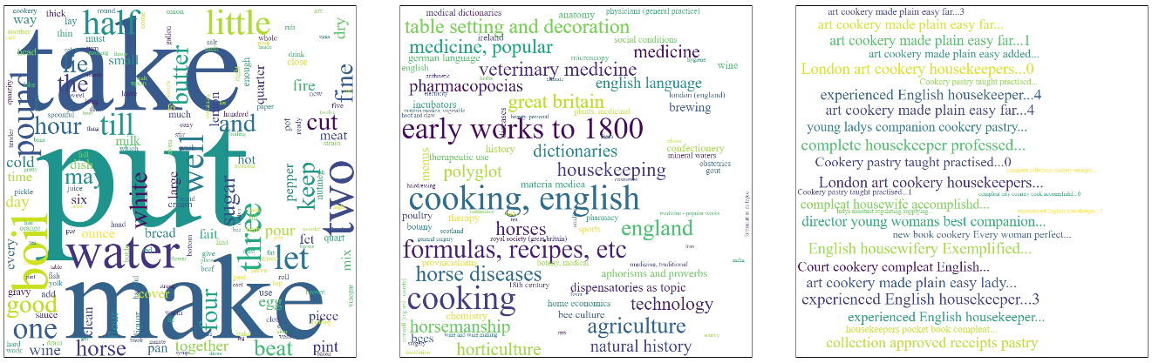
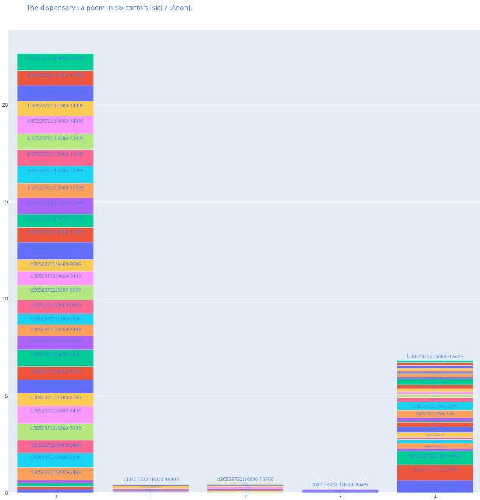
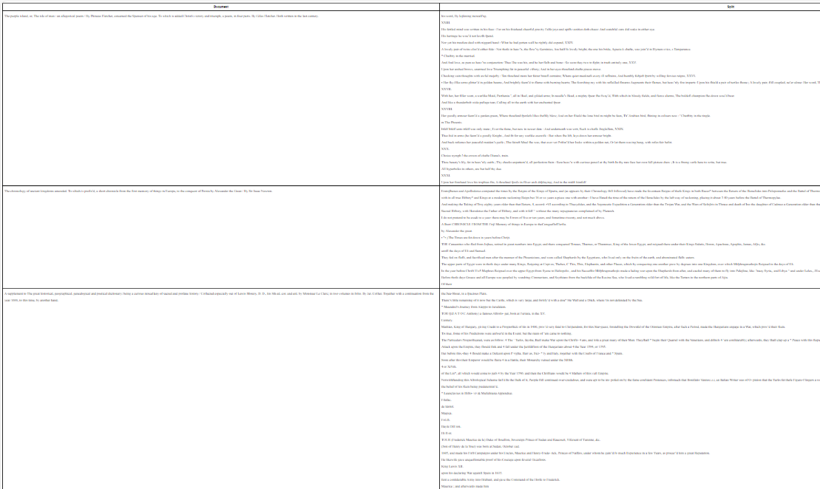
The thing that
Bernard made

Slide 14
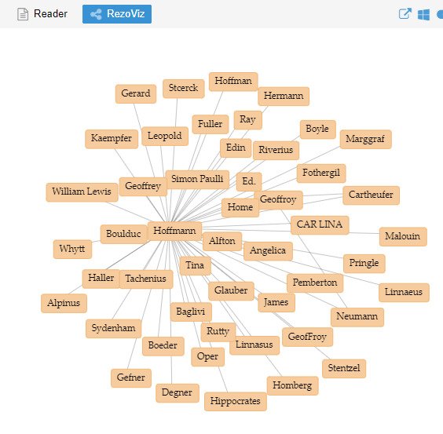
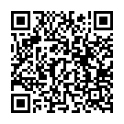
Co-occurring named entities
Co-occurring named
entities (via Voyant)
Connected entities occur together in the text
This (or similar) could be used to build networks, e.g. citation networks connecting texts together
Catalogue: https://wellcomecollection.org/works/xwe9pkn7
Text: https://api.wellcomecollection.org/text/v1/b30410332

Slide 15
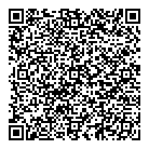
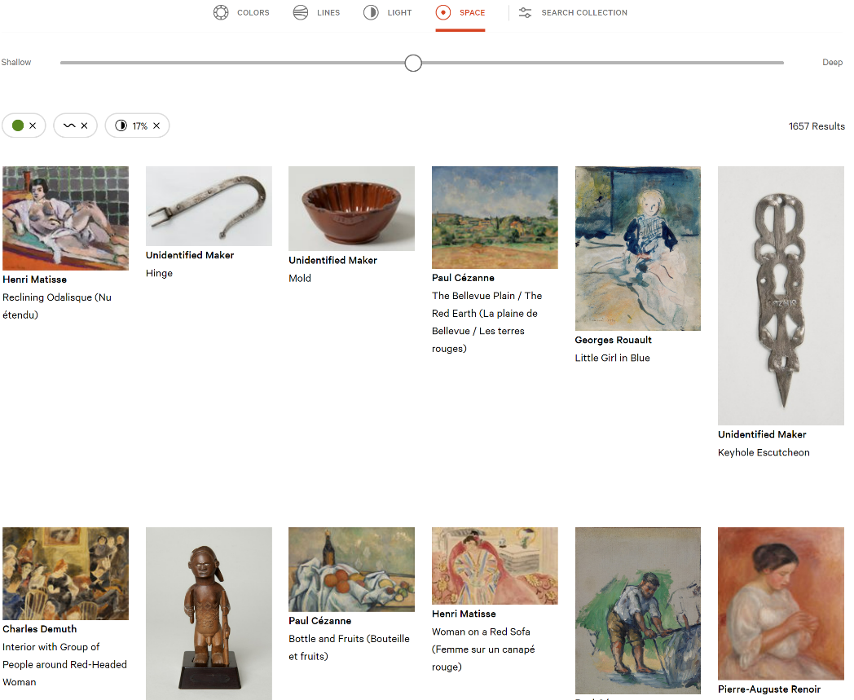
Barnes Collection
Barnes Collection
Search based on a range of visual properties – here green-ness, wavy lines, diffuse light.

Slide 16
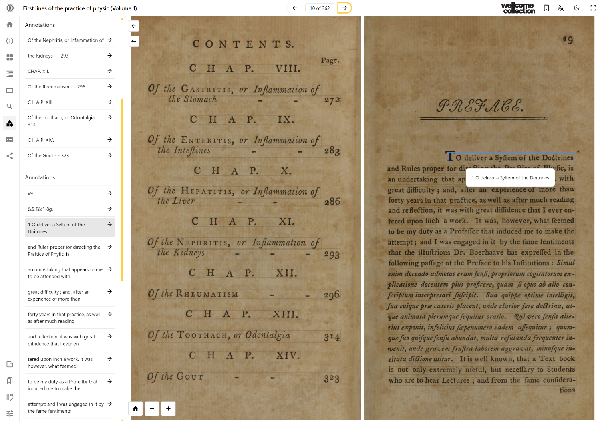
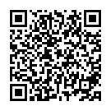
Theseus
Viewer

Slide 17
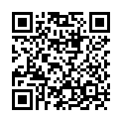
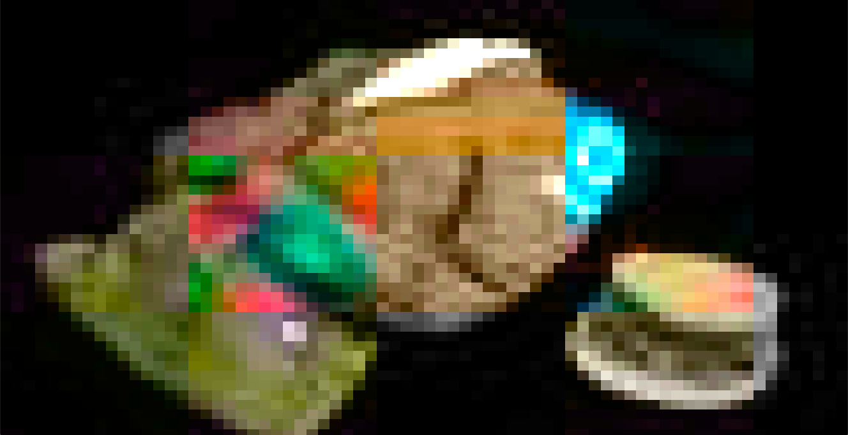
Never Been Seen
Never Been Seen
Never Been Seen presents a photograph of an item from the Science Museum’s collection that has never been viewed before.
Unfortunately down at the moment, but as I recall it shows a pixellated image initially which then resolves. Every time you refresh the page, you see a different unseen object.

Slide 18
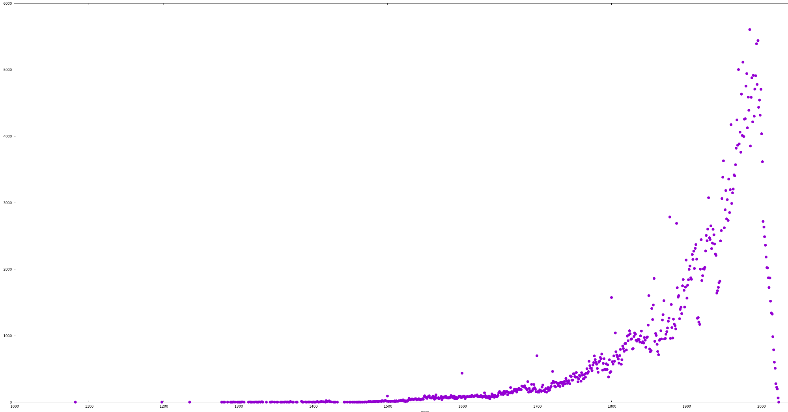
Catalogue items by year (all)
Catalogue items by year
You probably already produce things like this (but more accurate)

Slide 19
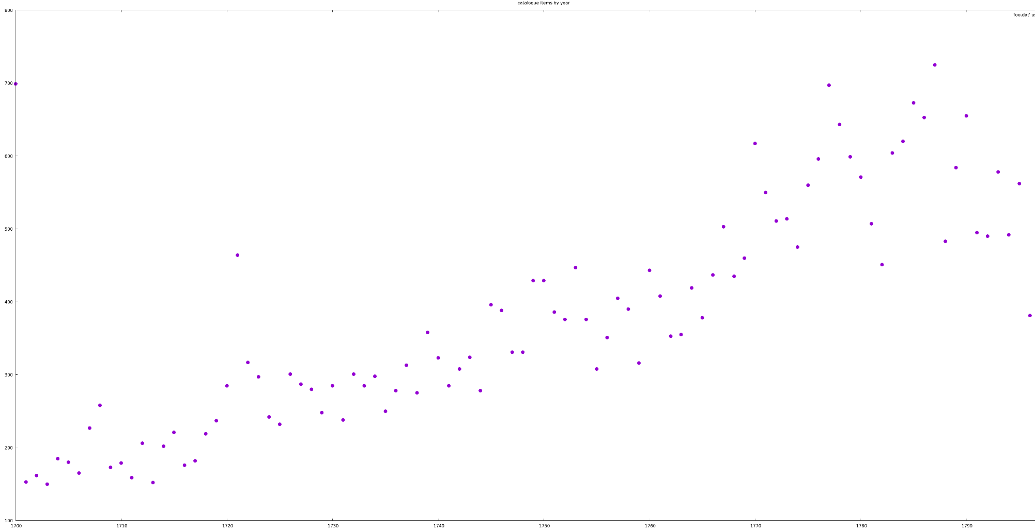
Catalogue items by year (18th century)
Catalogue items by year (18th century)
You probably already produce things like this (but more accurate)

Slide 20
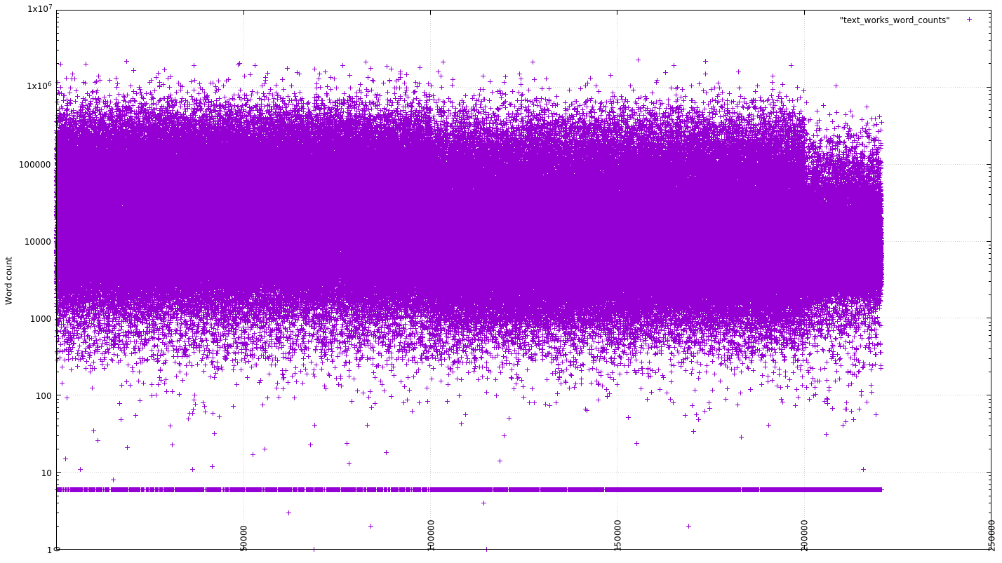
18th century words counts, unordered, log scale

